Slide 1
Seasonal flu prediction model
By nicholus magak

Slide 2
1. Business Understanding
Premise:
As the world struggles to vaccinate the global population against COVID-19, an understanding of how people’s backgrounds, opinions, and health behaviors are related to their personal vaccination patterns can provide guidance for future public health efforts. Your audience could be someone guiding those public health efforts.
Desired outcome:
Create a model that can accurately predict whether a person, based on their attributes given in the data both categorical and continuous is most likely given the seasonal flu (or depending if there is time, the H1N1) vaccine(s).
Eventually, the prediction algorithm can be used in identifying people with potential illness to the seasonal flu and either prevent or have a concrete solution in place due to early detection.

Slide 3
2. Data
The data consists of features/ variables that describe the outcome we want to predict i.e., Seasonal flu vaccinated or unvaccinated.
Due to the balanced data, the goal of the prediction was to focus on the model’s ability to achieve accuracy.
The

Slide 4
2. Data

Slide 5
3. Methods
The methods used to build the classification model are: Logistic Regression, Decision Tree Classifier, and Gaussian Naïve Bayes Classifier.
All the 3 methods were trained from data prepped from a train split. This ensured that we would have less chances of overfitting the model and having poor performance on the test set.
Each of the methods had their own levels of tuning with their own respective

Slide 6
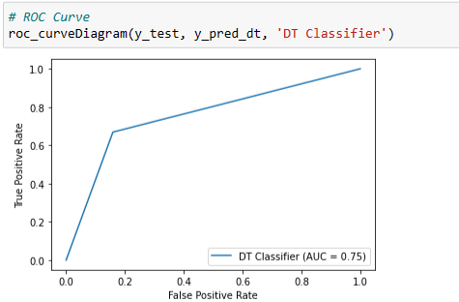
4. Modeling
The ROC score of the of the Decision Tree is 0.75
This means that

Slide 7
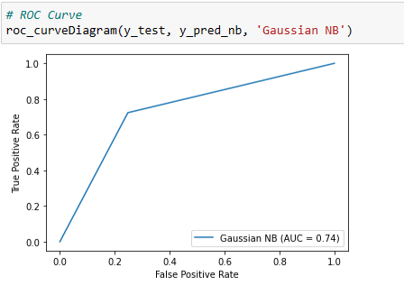
4. Modeling

Slide 8
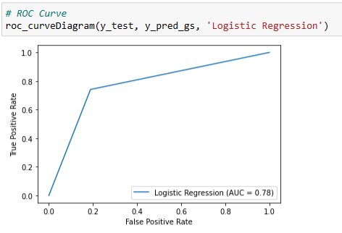
4. Modeling

Slide 9
Conclusion

